Slide 1

Navigate your path to graduate admission

Slide 2
Entrepreneurship Pitch Deck
Team
Danial Ahmad
Muhammad Ahmed Mohsin
Muhammad Ali Farooq
Muhammad Umer
Syeda Fatima Zahra

Slide 3

Problem
Students feel lost in the Grad School Maze!
The graduate school application process is complex and confusing
Unlike undergraduate admissions, graduate admissions are field-specific and put a far greater emphasis on research
Students struggle to
Identify research interests
Find relevant programs and professors
Connect with experienced mentors

Slide 4

The Solution: GradCompass
GradCompass aims to be a personalized guide for prospective graduate school applicants
Features
AI-powered Comparison Tool
Generates comprehensive comparisons Provides information such as research areas, active faculty, funding/stipends, and more Saves time and effort; provides convenience
One-stop Shop for Guidance
Connects students with experienced mentors; one-to-one mentorship Offers support with essays, research proposals, interview preparation, etc. Blogs/webinars aimed at imbuing confidence

Slide 5
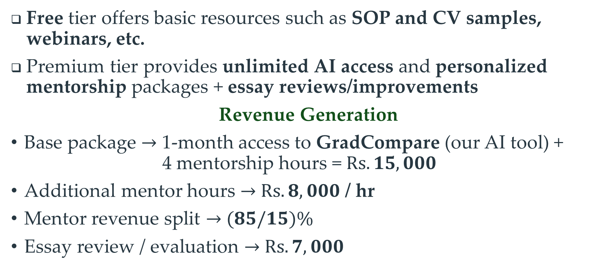
Business Model (Freemium)
Free tier offers basic resources such as SOP and CV samples, webinars, etc.
Premium tier provides unlimited AI access and personalized mentorship packages + essay reviews/improvements
Revenue Generation
Base package $→$ 1-month access to GradCompare (our AI tool) + 4 mentorship hours = $Rs. 15,000$
Additional mentor hours $→$ $Rs. 8,000$ / hr
Mentor revenue split $→$ $(85/15)\%$
Essay review / evaluation $→$ $Rs. 7,000$

Slide 6
Unique Selling Proposition (USP)
Why choose GradCompass?
GradCompass is a one-stop shop for graduate school applicants
Graduate Studies!
Our focus is on MS and PhD Emphasis on research
Comprehensive
All the resources you need in one place
Innovation
AI powered *Retrieval-Augmented Generation (RAG)

Slide 7
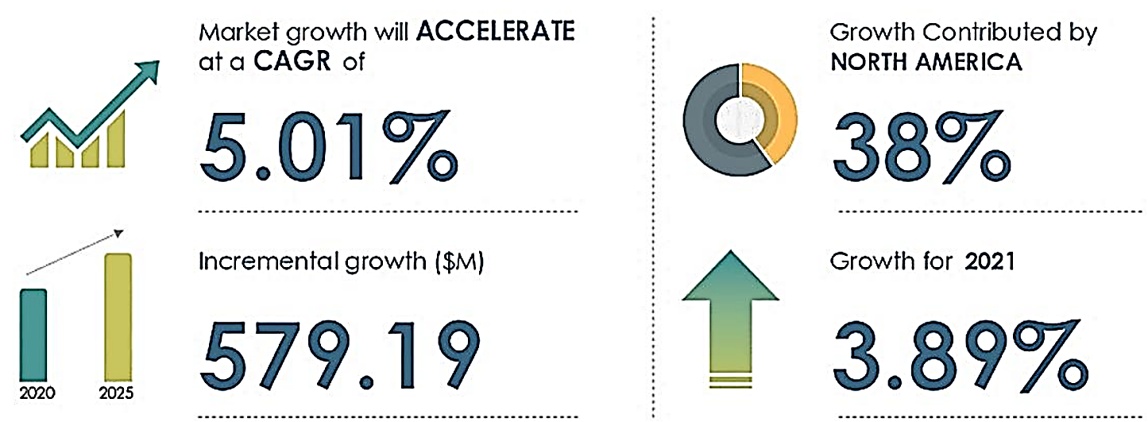
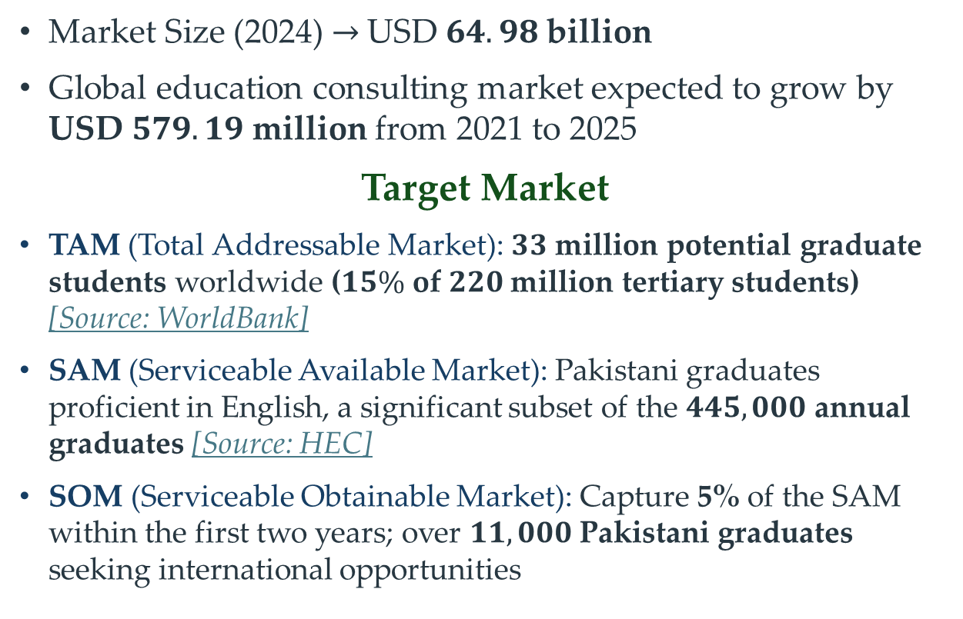
Industry Analysis: Education Consulting
Market Size (2024) $→$USD $64.98$ billion
Global education consulting market expected to grow by USD $579.19$ million from 2021 to 2025
Target Market
TAM (Total Addressable Market): $33$ million potential graduate students worldwide ($15\%$ of $220$million tertiary students) [Source: WorldBank]
SAM (Serviceable Available Market): Pakistani graduates proficient in English, a significant subset of the $445,000$ annual graduates [Source: HEC]
SOM (Serviceable Obtainable Market): Capture 5% of the SAM within the first two years; over $11,000$ Pakistani graduates seeking international opportunities
Source: Technavio

Slide 8


Porter’s Five Forces
Competitors
Threat of New Entrants
Easy to enter; difficult to build brand & network
Bargaining Power of Buyers
Limited options to students for graduate schools
Bargaining Power of Suppliers
Diverse resources & services available
Threat of Substitutes
Few alternatives (guidebooks, forums); None personalized for students
Competitive Rivalry
Competitive landscape; No clear focus on graduate admissions

Slide 9
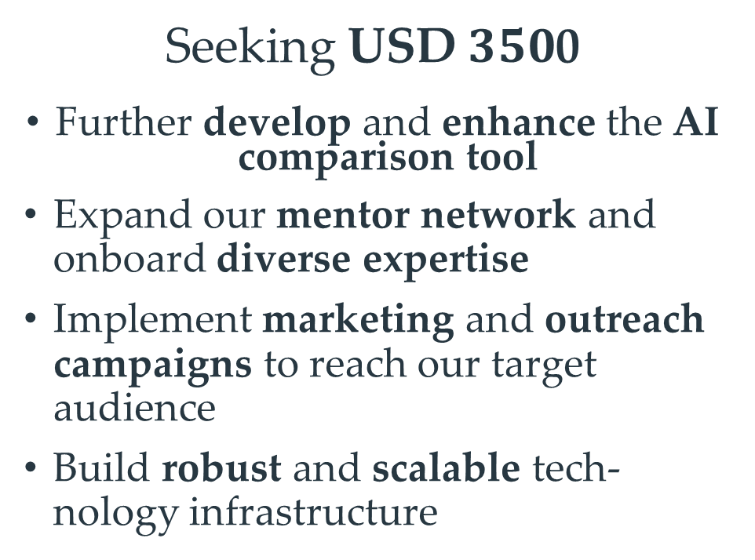


Funding (The Need)
AI Pricing $→$ $\$21 / 1$million tokens
Using a conservative value of $250k$ tokens / 100 comparisons, we estimate $\$5$ / per student
Seeking USD$350$0
Further develop and enhance the AI comparison tool
Expand our mentor network and onboard diverse expertise
Implement marketing and outreach campaigns to reach our target audience
Build robust and scalable tech-nology infrastructure
AI models for both automated web scraping and tuning models
$\$300$/ one full-cycle (scraping + tuning)
twice per fiscal quarter
Rest of the funding towards marketing and reliable infrastructure until turnover

Slide 10


AI Comparison Tool
Usage Demo
Powered by
GradCompare by GradCompass
Open in Browser

Slide 11
